Slide 1
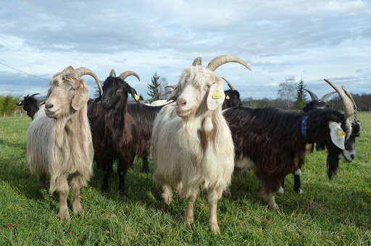
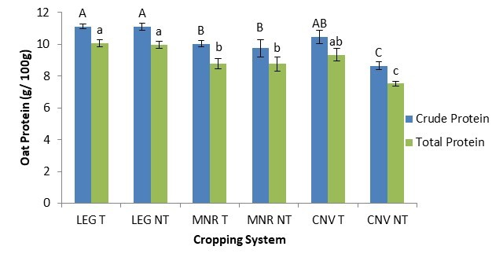
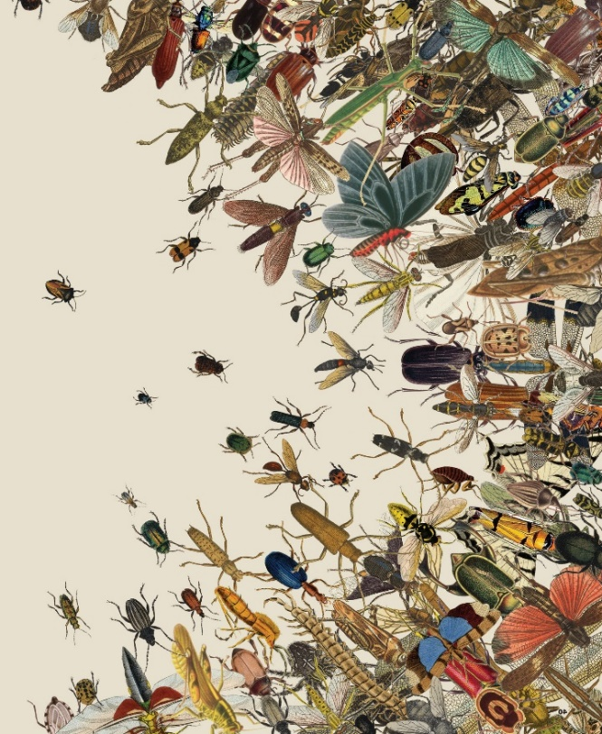
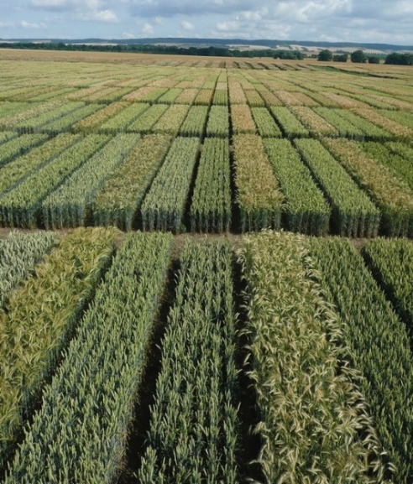

C7041 Experimental Design and Analysis
Ed Harris

Slide 2
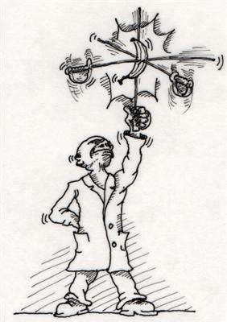
2.12: Multivariate statistics

Slide 3
Outline
Why do a multivariate analysis?
Ordination, classification, model fitting
Principal component analysis
Discriminant analysis, quickly
Species presence/absence data
Distance data

Slide 4
Data are usually multivariate
Typically we measure multiple variables on the populations, species, and ecosystems that we study.
This creates a challenge: how to analyse and display many measurements of all those variables?
We need ways to make it easier to find the important patterns and relationships among the many variables.

Slide 5
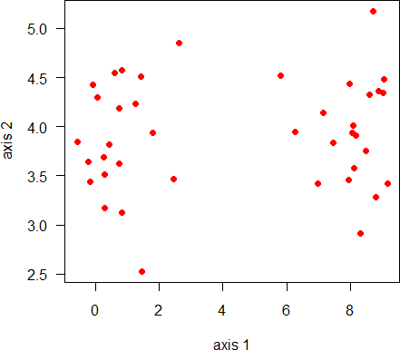
Ordination is usually what we want:
Arrange sampling units along gradients or according to combinations of variables
Goals:
Visualize complex data in few dimensions
Find meaningful combinations of the original variables that can be used in subsequent analyses
multivariate analysis
Large number of variables

Slide 6
Ordination, Classification, Model fitting
Multivariate methods are also used for
Ordination (like PCA): data from many sites or populations are represented as points in a “multidimensional space”
Classification: place sampling units into groups
Model fitting: multivariate analysis of variance; multiple regression
We’ll start with Principal Components Analysis because it is the most straightforward multivariate method.

Slide 7
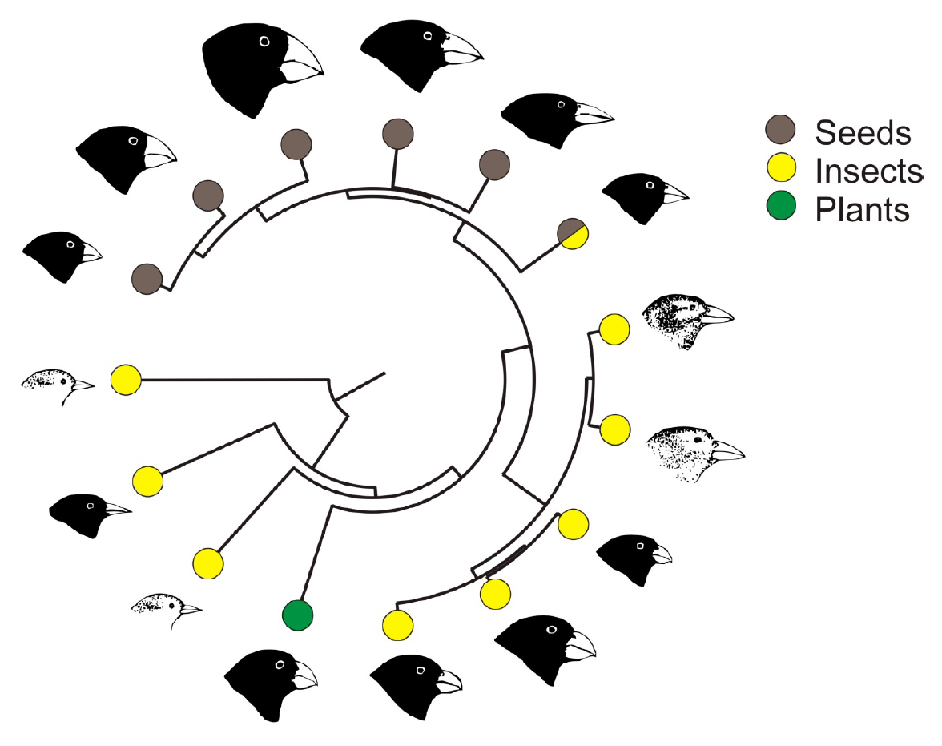
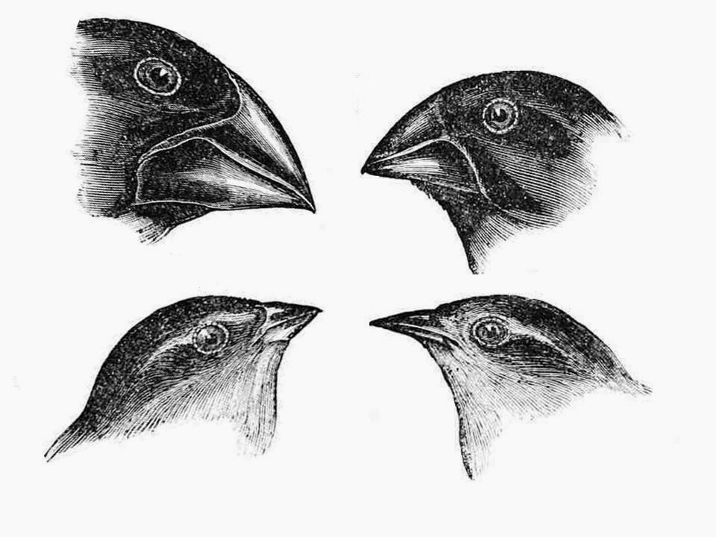
Principal Component Analysis
Example 1: Differences in beak and body dimensions of Darwin’s finches

Slide 8
mydata <- Data frame of means for 14 species of 5 traits
Principal Component Analysis
VARIABLES (traits)
 | wingL | tarsusL | culmenL | beakD | gonysW
C.heliobates | 68.79 | 21.35 | 10.45 | 6.75 | 6.78
C.pallida | 71.2 | 21.96 | 11.36 | 7.51 | 7.02
C.parvulus | 62.28 | 19.55 | 7.2 | 6.51 | 6.13
C.pauper | 68.89 | 20.82 | 8.91 | 7.95 | 7.11
C.psittacula | 69.34 | 21.11 | 9.25 | 9.34 | 8.06
UNITS (species) Certhidea.fusca | 59.02 | 20.04 | 8.57 | 4.56 | 5.04
Certhidea.olivacea | 52.48 | 19.1 | 7.3 | 3.17 | 4.11
G.conirostris | 77.47 | 19.77 | 14.22 | 12.35 | 10.59
G.difficilis | 68.31 | 18.15 | 9.75 | 7.47 | 6.89
G.fortis | 69.69 | 18.08 | 11.1 | 10.62 | 9.22
G.fuliginosa | 62.36 | 16.55 | 8.13 | 6.97 | 6.33
G.magnirostris | 81.79 | 20.88 | 15.25 | 16.84 | 14.53
G.scandens | 70.9 | 18.71 | 13.76 | 8.54 | 7.67
Pinaroloxias | 65.93 | 19.69 | 10.09 | 4.7 | 5.1
Platyspiza | 83.43 | 26.24 | 10.26 | 10.37 | 9.81

Slide 9
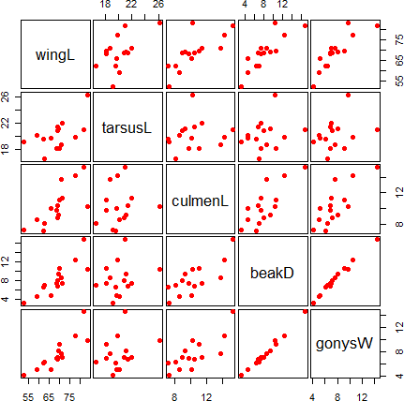
Principal Component Analysis
There are only 5 variables but visualizing them represents a challenge
pairs(mydata)

Slide 10
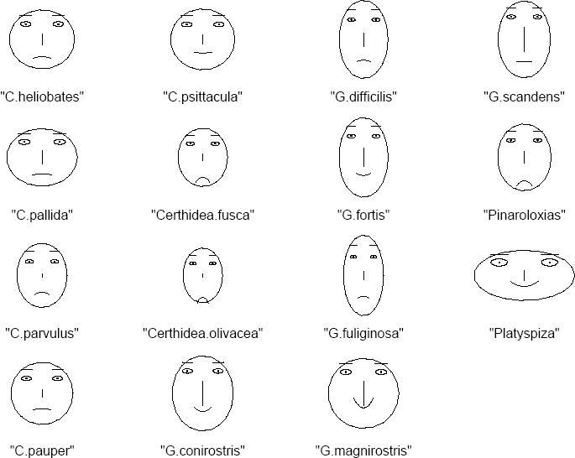
How to visualize multivariate data?
Principal Component Analysis
“Chernoff faces” display multivariate data in the shape of a human face.
The individual parts of the face represent values of the variables by their shape, size, placement and orientation.
Humans are good at distinguishing faces…

Slide 11
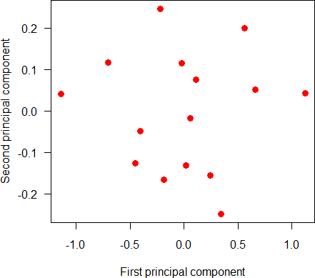
PCs are linear combinations of the original variables. 96% of all the variation among the Darwin’s finch species is described by just 2 dimensions or principal components. This is because the traits strongly co-vary among species.
Principal Component Analysis

Slide 12
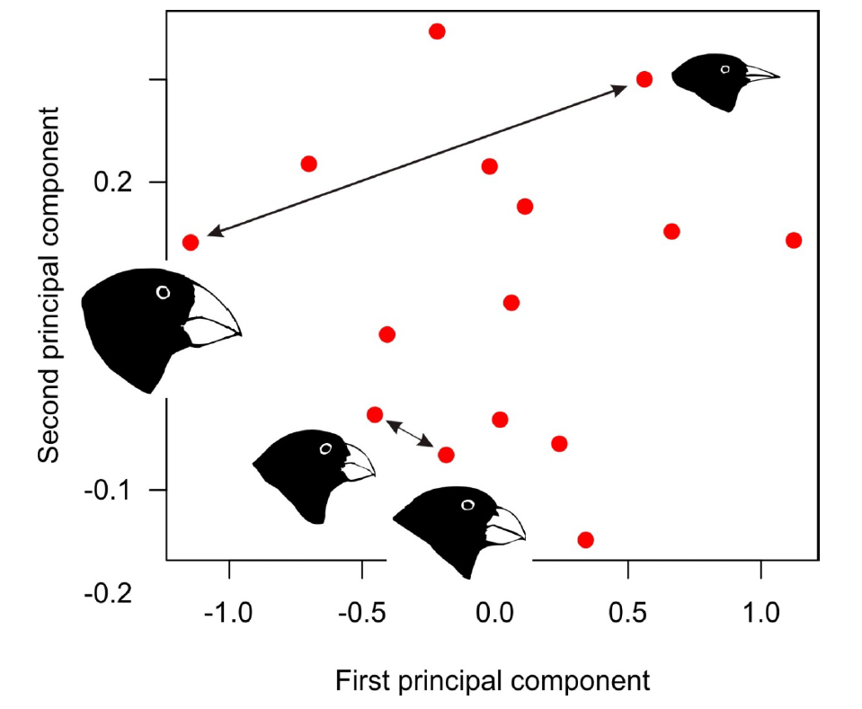
Even though we’re visualizing 5 dimensions of data in only 2 dimensions, distances between species are approximately preserved. Points close together indicate species that are similar. Points far apart indicate species that are more different.
Principal Component Analysis

Slide 13
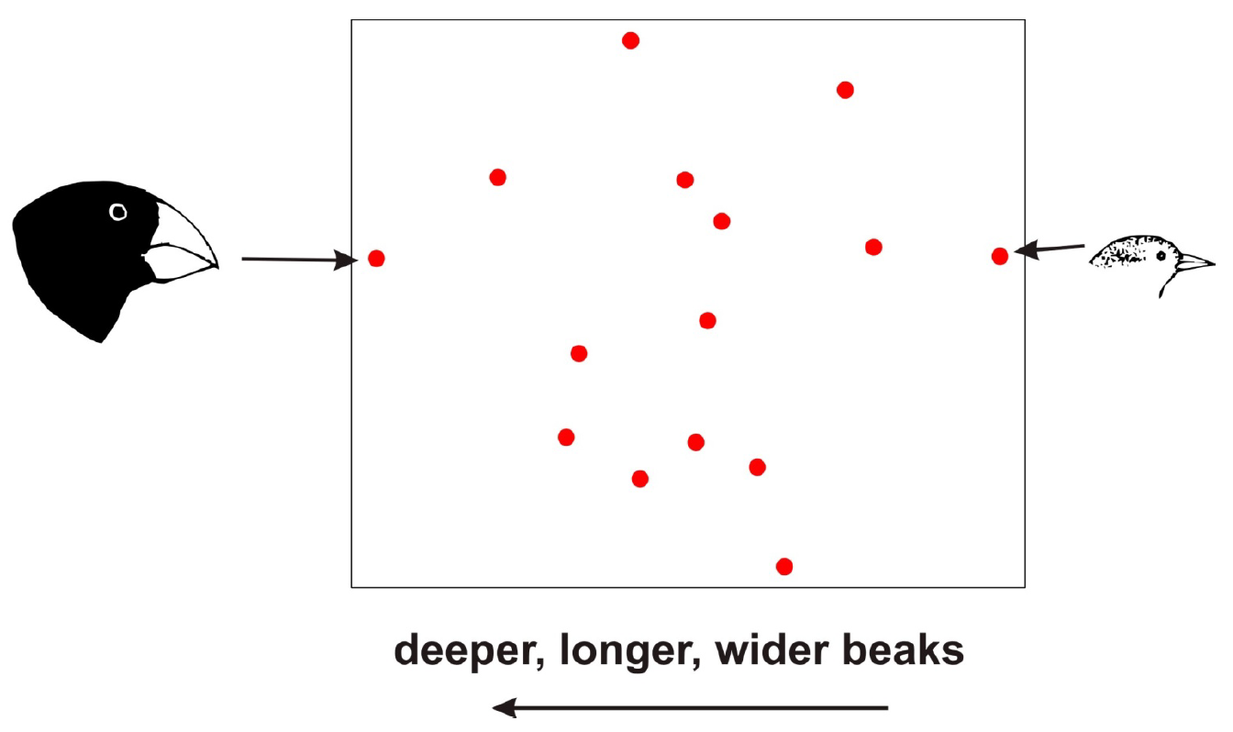
Even though they are composite variables, the axes in this case are interpretable. The first axis arranges the species according to differences in overall beak size.
Principal Component Analysis

Slide 14
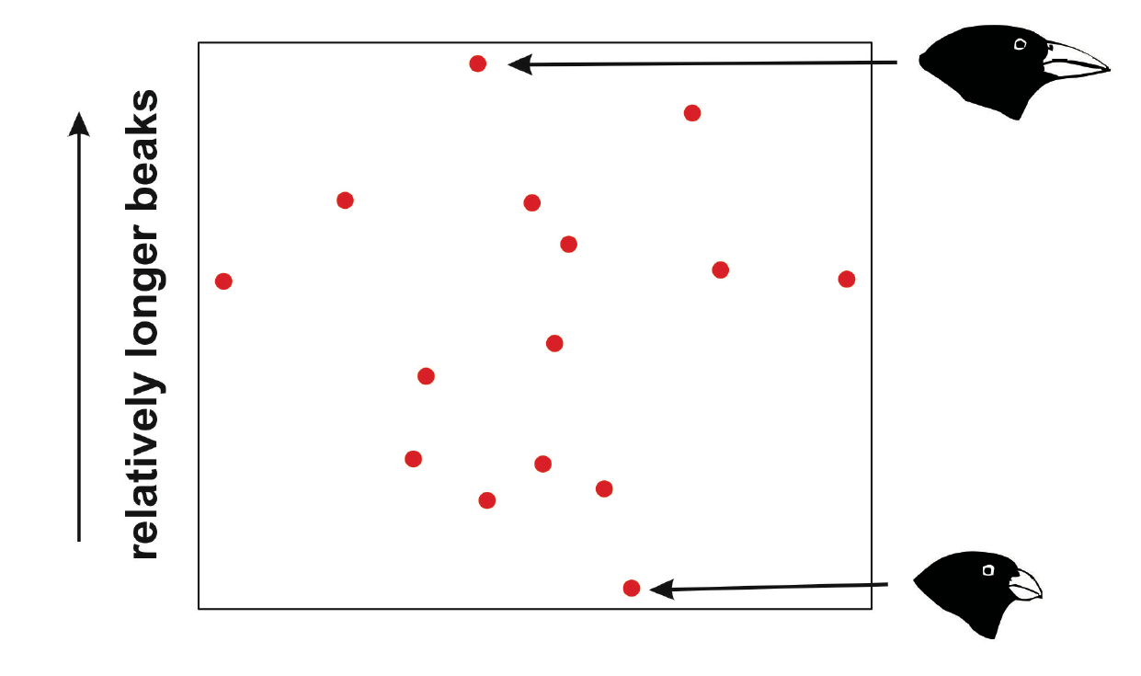
Principal Component Analysis
The second axis arranges the species according to differences in beak length (relative to overall beak size). It represents an axis of beak shape.

Slide 15
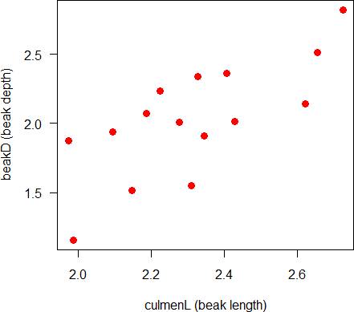
How it works
Principal Component Analysis
PCA amounts to nothing more than a rotation of the axes,
Allows you to view much of the data in a small number of dimensions
Imagine just two traits were measured instead of 5 (log-transformed to put on a similar scale)
What does PCA do?

Slide 16
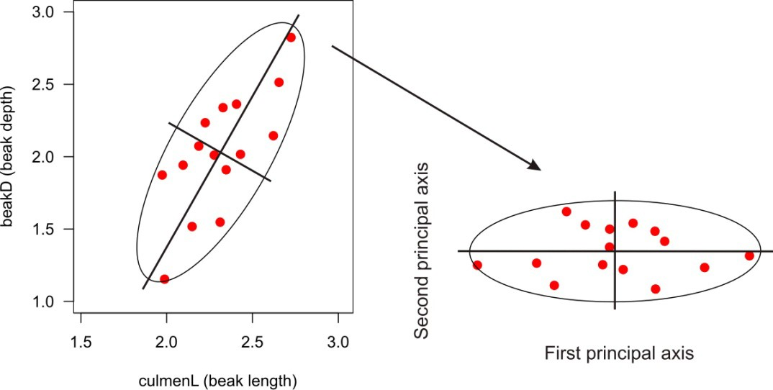
Rotates the original scatter of points so that new axes are uncorrelated
Principal Component Analysis
How it works

Slide 17
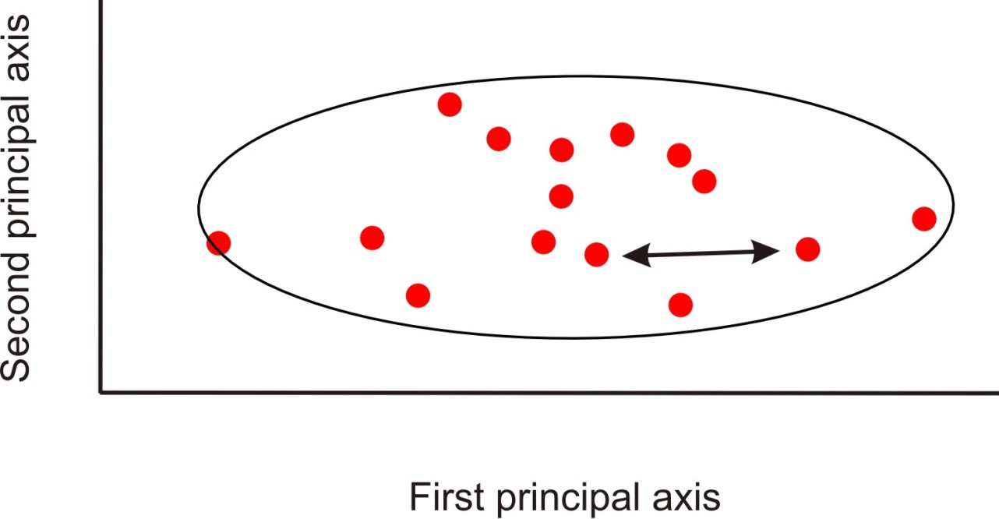
Principal Component Analysis
How it works
Because it is nothing more than a rotation of the axes, the Euclidean distances between pairs of species are unaltered by the transformation (provided that all the PC axes are retained*).
*Warning: in some non-R programs the default procedure is to standardize the variables (“correlation matrix”) before carrying out the analysis. Use the correlation matrix if variables don’t have a common scale. Euclidean distances will then be based on standardized data, not the original measurements.

Slide 18
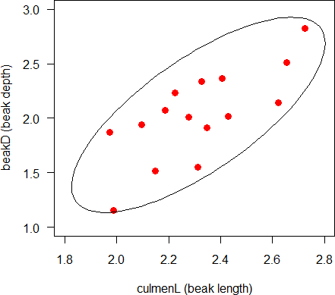
Principal Component Analysis
How it works
The computations behind the scenes involve describing the data by the associations between the variables (illustrated by the ellipse)
The elements of the covariance matrix:
 | x1 | x2
x1 | var(x1) | cov(x1,x2)
x2 | cov(x1,x2) | var(x2)
For the two finch variables:
culmenL beakD
culmenL beakD
0.0518 0.0698
0.0698 0.1741

Slide 19

Principal Component Analysis
The covariance matrix of the new, composite variables has variances on the diagonal and zeros off the diagonal. The component axes have zero covariance.
 | pc1 | pc2
pc1 | 0.192 | 0
pc2 | 0 | 0.019
These variances are called the eigenvalues
They sum to the same total as the sum of the variances of the original traits.

Slide 20
Principal Component Analysis
The vectors that contain the constants for transforming the original variables into the principal components are called the eigenvectors.
eigenvec1 eigenvec2
culmenL | 0.413 | -0.911
beakD | 0.911 | 0.413
These constants are called loadings.

Slide 21

Principal Component Analysis
eigenvec1 eigenvec2
culmenL | 0.413 | -0.911
beakD | 0.911 | 0.413
The constants are called loadings because they indicate the contribution of each variable to the principal component.
pc1 can be interpreted as “beak size” because both beak traits make contributions having the same sign (depth contributes more than length). The axis separates big- beaked birds at one extreme from small-beaked birds at the other.
pc2 is interpreted as “beak shape” because beak depth loads positively but beak length negatively. It separates short deep beaks at one end from long shallow beaks at the other.

Slide 22
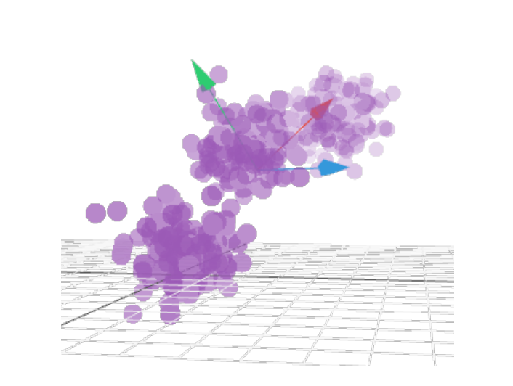
Principal Component Analysis
We can still visualize this process with 3 variables instead of 2… it gets hard to visualize with more than 3 variables
3D example

Slide 23
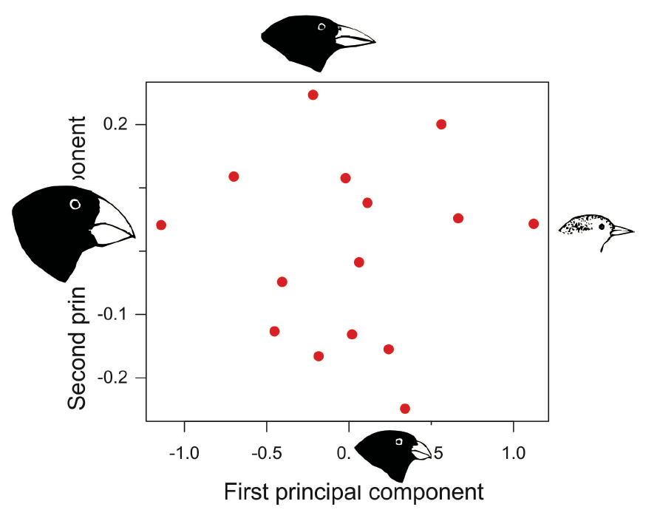
The idea is the same with 5, or any number of variables. The plot is the first two PC axes for all 5 variables for the 15 Darwin’s finch species. When we look at only the first two principal components we aren’t seeing all the differences among the species (but it is > 40%, probably a lot more…!).
Principal Component Analysis

Slide 24
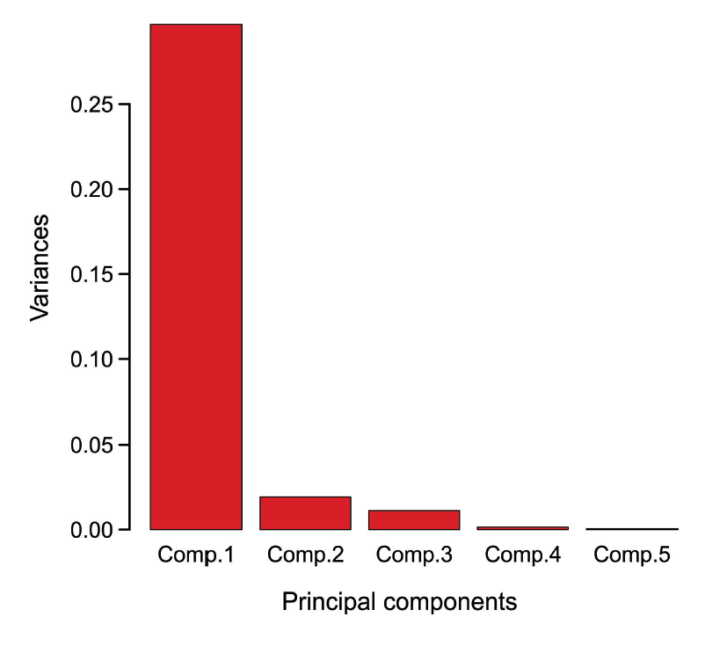
The eigenvalues tell you how much of the total variation is captured by the first two principal components. These can be visualized in a “scree plot”.
Principal Component Analysis

Slide 25
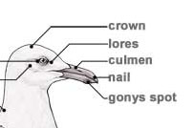
The eigenvectors indicate the "loadings"
Principal Component Analysis
For the Darwin’s finch data:
PC1 can be interpreted as “beak size”.
PC2 can be interpreted as “beak (culmen) shape”
PC3 is mainly one trait, tarsus length
Etc…
 | PC1 | PC2 | PC3 | PC4 | PC5
wingL | -0.195 | 0.062 | -0.335 | 0.577 | 0.716
tarsusL -0.052 -0.043 -0.919 -0.071 -0.383
culmenL -0.326 0.932 0.039 0.002 -0.153
beakD -0.733 -0.330 0.193 0.395 -0.400
gonysW -0.562 -0.127 -0.073 -0.711 0.397

Slide 26
Principal Component Analysis
Example 2: 197146 traits in 1387 individual humans sampled from Europe. Data are loci (nucleotides) in the human genome.
At every locus, individuals of genotypes AA, Aa and aa are scored as 0, 1 and 2.
The covariance matrix is 197146 × 197146 in size.
PC1 and PC2 are illustrated. Points are individuals.
Colors are countries. Circles are country means.
Individuals cluster by country.
Novembre et al (2008) Nature

Slide 27
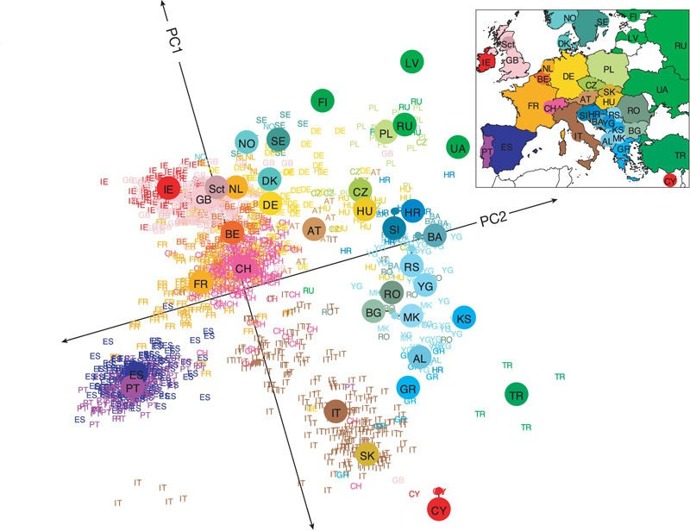
Principal Component Analysis
The authors rotated the figure and placed it next to a map of Europe.
A strong correspondence was observed between position of individuals in PC1 and PC2 space and geographical map position
Land configuration influenced patterns of gene flow between countries…
Novembre et al (2008) Nature

Slide 28
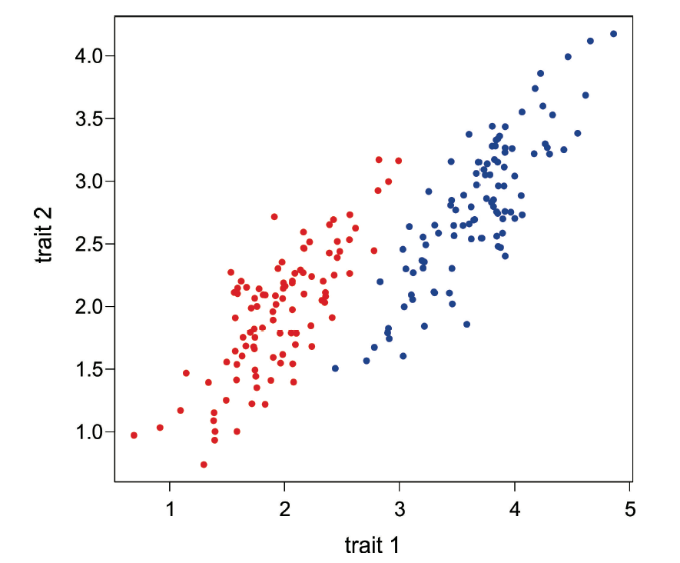
Discriminant function analysis, quickly
Discriminant function analysis is for classification rather than ordination.
It finds axes that maximally separate two or more previously identified groups. It finds axes that maximize variation among groups relative to variation between groups. These axes can then be used to classify new observations into the same groups.

Slide 29
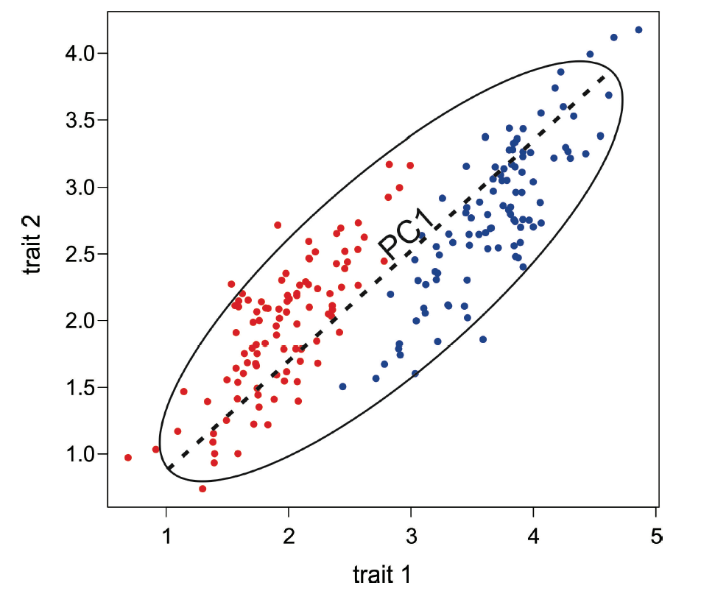
Discriminant function analysis
In contrast, principal component analysis ignores the groups, and only finds the directions of maximum total variance,

Slide 30
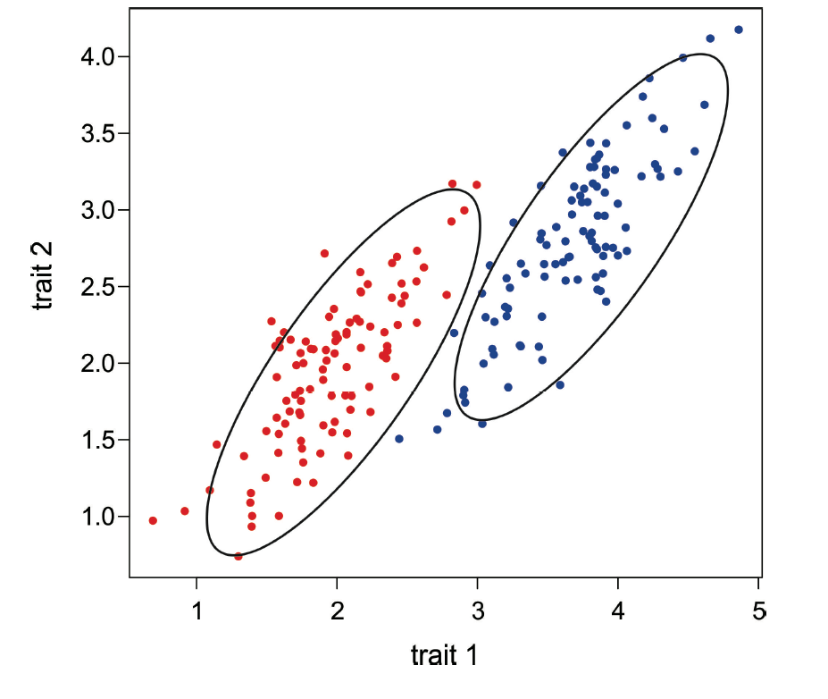
Discriminant function analysis
Discriminant function analysis explicitly finds the axes that best separate the groups. It doesn’t do this simply by finding the direction of the biggest difference between means.

Slide 31
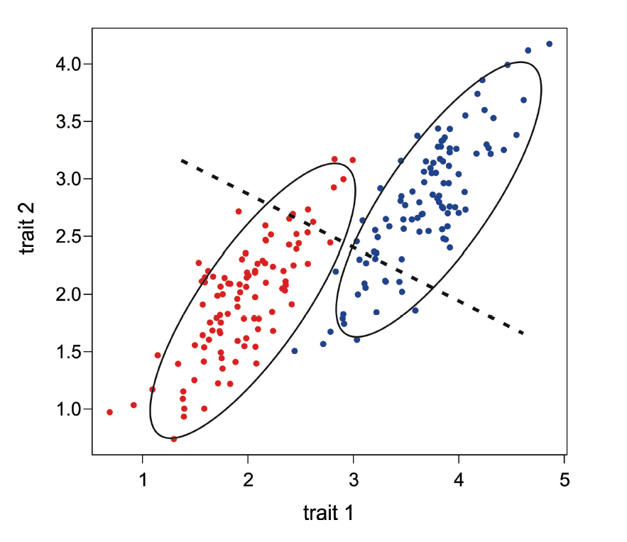
Discriminant function analysis
Instead, it finds the axes that best separate groups relative to within-group variation.

Slide 32
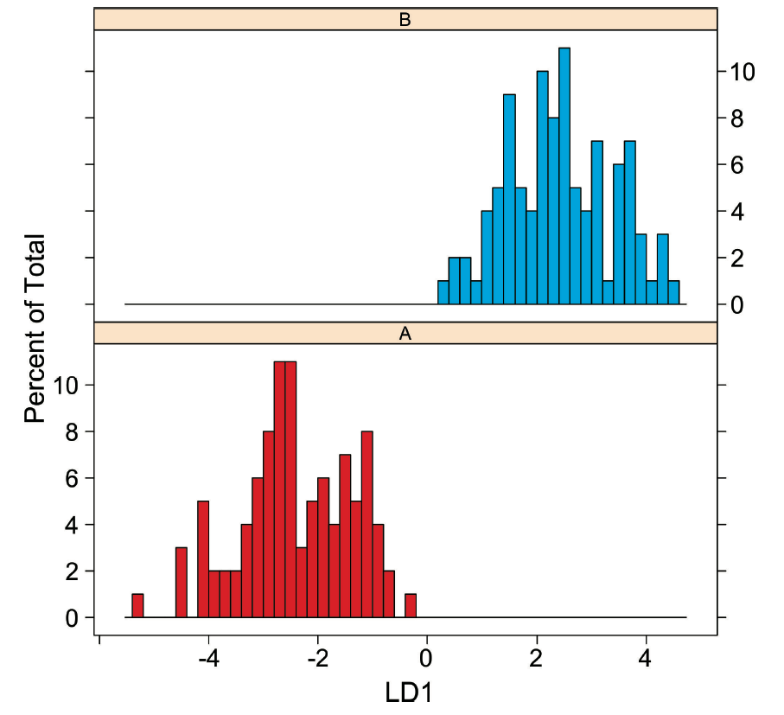
Discriminant function analysis
The resulting axes best separate the groups in the data, and can be used for classification of new observations.

Slide 33
Correspondence Analysis
An ordination method to visualize spatial associations between species based on their presence/absence (or abundance) at sites. Equivalently, the method visualizes differences among sites in the extent to which they share the same species.
The method is like principal component analysis.
Instead of using a covariance matrix describing association between pairs of traits (as in PCA), correspondence analysis uses a contingency table to measure association between all pairs of species based on their frequency of co-ocurrence (measured relative to the co-occurrence expected under independence).
Equivalently, it measured association between all pairs of sites based on the number of shared species (relative to the random expectation).

Slide 34
Correspondence Analysis
Example: Presence/absence of 16 ant species in 4 geographic regions (Gotelli and Ellison 2004). In this matrix, the sites are the spatial units, and the species are the variables. The data are 1 (species is present) or 0.
VARIABLES (ant species)
a1 a2 a3 a4 a5 a6 a7 a8 a9 a10 a11 a12 a13 a14 a15 a16
Site
1. CT | 0 1 0 1 0 0 0 1 1 0 | 1 | 0 | 0 | 0 | 1 | 1
UNITS 2. MA.mainland | 1 1 1 1 0 1 1 1 1 1 | 1 | 0 | 1 | 0 | 1 | 0
3. MA.islands | 1 0 0 0 1 1 1 1 1 1 | 1 | 1 | 1 | 0 | 1 | 1
4. VT | 0 1 0 1 0 0 1 1 1 0 | 1 | 0 | 0 | 1 | 1 | 1

Slide 35
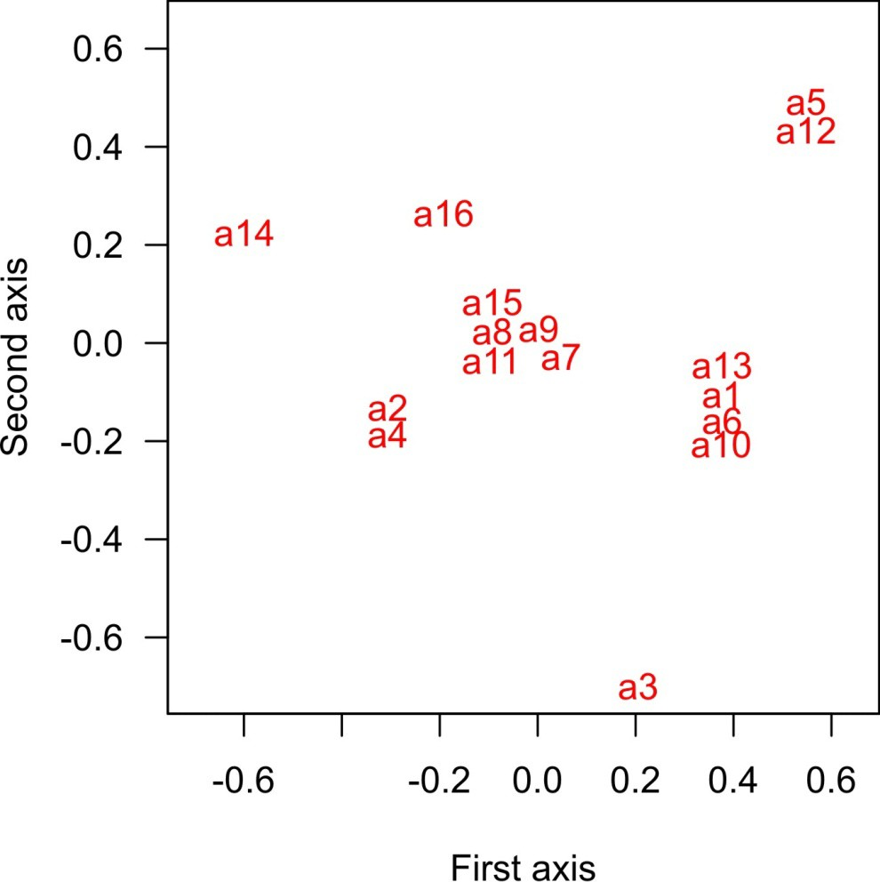
Correspondence Analysis
Applied to the ants, correspondence analysis produces a plot in which points close together on the axes indicate species that often co- occur at sites. Points far apart indicate species that occur infrequently at the same sites.

Slide 36
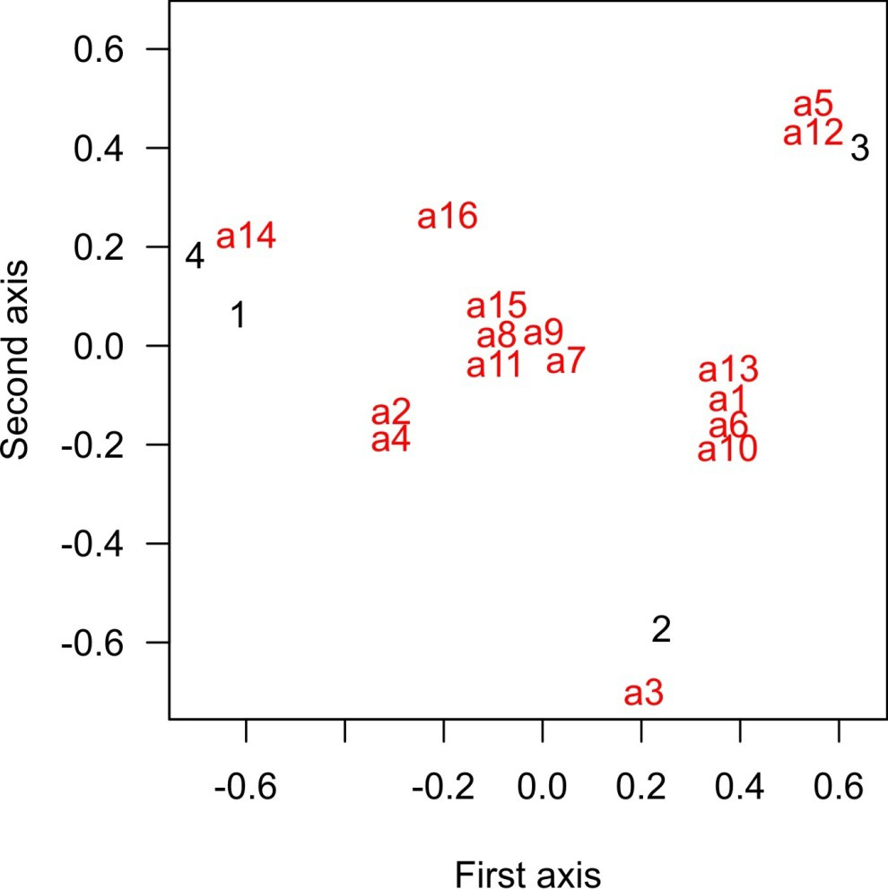
Correspondence Analysis
Likewise, the sites can be compared by the observed and expected numbers of species shared. The method can thus ordinate sites and species simultaneously on the same axes.
Species next to sites in the plot indicate species that occur predominantly there, whereas species falling between site points are shared among sites.

Slide 37
Correspondence Analysis
By rearranging the site and ant species by their order along the first axis, we can see the “correspondence” between sites and species.
Site a14 a2 a4 a16 a15 a8 a11 a9 a7 a3 a1 a13 a6 a10 a5 a12
4. VT | 1 | 1 1 1 | 1 | 1 1 | 1 1 0 0 0 | 0 0 | 0 0
UNITS 1. CT | 0 | 1 1 1 | 1 | 1 1 | 1 0 0 0 0 | 0 0 | 0 0
2. MA.mainland | 0 | 1 1 0 | 1 | 1 1 | 1 1 1 1 1 | 1 1 | 0 0
3. MA.islands | 0 | 0 0 1 | 1 | 1 1 | 1 1 0 1 1 | 1 1 | 1 1

Slide 38
Correspondence Analysis
This first axis behaves like an ecological gradient, with species found at all sites in the middle, and species with non-overlapping distributions at either end.
Site a14 a2 a4 a16 a15 a8 a11 a9 a7 a3 a1 a13 a6 a10 a5 a12
4. VT | 1 | 1 1 1 | 1 | 1 1 | 1 1 0 0 0 | 0 0 | 0 0
UNITS 1. CT | 0 | 1 1 1 | 1 | 1 1 | 1 0 0 0 0 | 0 0 | 0 0
2. MA.mainland | 0 | 1 1 0 | 1 | 1 1 | 1 1 1 1 1 | 1 1 | 0 0
3. MA.islands | 0 | 0 0 1 | 1 | 1 1 | 1 1 0 1 1 | 1 1 | 1 1

Slide 39
Correspondence Analysis
The first axis explains most of the variation in the data. It also maximizes the association between units (sites, rows) and variables (species, columns).
Eigenvalues for each axis indicate the correlation between species and site scores.
For the ant data: Axis 1: 0.56
Axis 2: 0.39

Slide 40
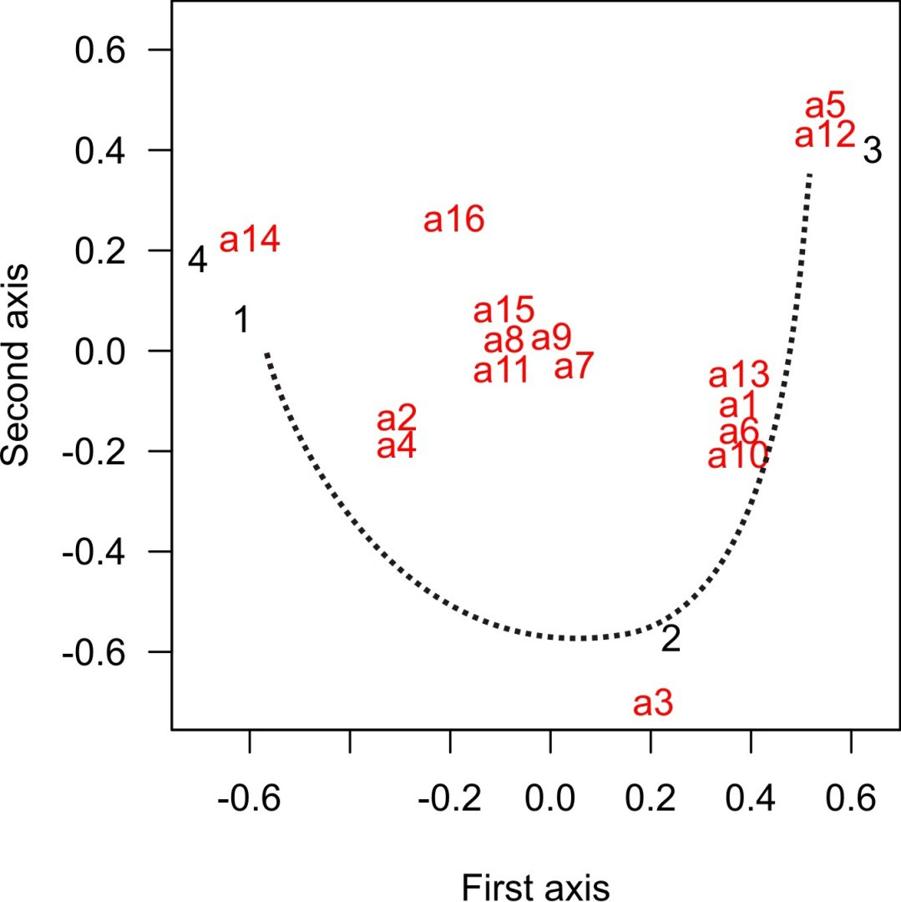
Correspondence Analysis
A worry with CA in general is the “arch” or, more seriously, a “horseshoe” in the ordination. When sites at the ends of ecological gradients have few species in common, they may be arranged such that they appear “similar” on axis 2 only because they are missing some of the same species.
It arises because the measure of distance between assemblages is not linear and doesn’t increase with increasing “ecological distance”. The problem is most acute when spatial turnover of species (beta diversity) is high.

Slide 41
Distance data
Can be analyzed similarly.
Example: Percent sequence divergence between Pacific Ocean basin freshwater stickleback populations in over 1000 bp of the Eda gene.
 | BC1 | BC2 | WA1 | CAL1 | AK1 | AK2 | BC3 | CAL2 | CAL3
BC1 | 0.00000 | 0.00076 | 0.00454 | 0.00683 | 0.00680 | 0.00454 | 0.00605 | 0.00531 | 0.00681
BC2 | 0.00076 | 0.00000 | 0.00530 | 0.00758 | 0.00605 | 0.00530 | 0.00529 | 0.00607 | 0.00757
WA1 | 0.00454 | 0.00530 | 0.00000 | 0.00683 | 0.00302 | 0.00378 | 0.00151 | 0.00530 | 0.00681
CAL1 | 0.00683 | 0.00758 | 0.00683 | 0.00000 | 0.00988 | 0.00988 | 0.00834 | 0.00531 | 0.00379
AK1 | 0.00680 | 0.00605 | 0.00302 | 0.00988 | 0.00000 | 0.00302 | 0.00151 | 0.00833 | 0.00983
AK2 | 0.00454 | 0.00530 | 0.00378 | 0.00988 | 0.00302 | 0.00000 | 0.00530 | 0.00835 | 0.00985
BC3 | 0.00605 | 0.00529 | 0.00151 | 0.00834 | 0.00151 | 0.00530 | 0.00000 | 0.00682 | 0.00832
CAL2 | 0.00531 | 0.00607 | 0.00530 | 0.00531 | 0.00833 | 0.00835 | 0.00682 | 0.00000 | 0.00378
CAL3 | 0.00681 | 0.00757 | 0.00681 | 0.00379 | 0.00983 | 0.00985 | 0.00832 | 0.00378 | 0.00000

Slide 42
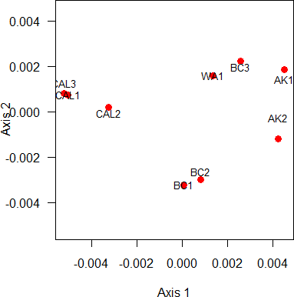
Distance data
Various forms of “multidimensional scaling” use distance measurements. The overall goal is to produce a plot in which data points that are similar are close to one another in the plot, whereas points apart from one another are more similar.
Distances may not be preserved, because in non-metric scaling only the rank order of distances between points is maintained.

Slide 43
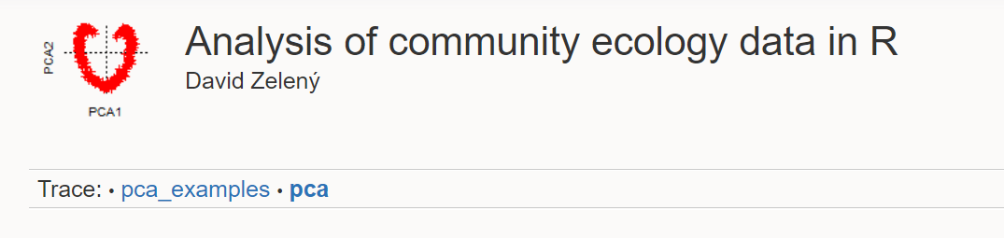
Suggested reading
https://www.davidzeleny.net/anadat-r/doku.php/en:pca

